Slide 1
Algorithms
Solving Recurrences Continued
The Master Theorem
David Luebke <number> 11/08/26

Slide 2
Review: Solving Recurrences
Substitution method
Iteration method
Master method
David Luebke <number> 11/08/26

Slide 3
Review: Solving Recurrences
The substitution method
  A.k.a. the “making a good guess method”
  Guess the form of the answer, then use induction to find the constants and show that solution works
  Run an example: merge sort
    T(n) = 2T(n/2) + cn
    We guess that the answer is O(n lg n)
    Prove it by induction
  Can similarly show T(n) = Ω(n lg n), thus Θ(n lg n)
David Luebke <number> 11/08/26

Slide 4
Let’s solve T(n) = 2T(n/2) + n
Guess T(n) ≤ cn log n for some constant c (that is, T(n) = O(n log n))
Proof: ∗ Base case: we need to show that our guess holds for some base case (not necessarily n = 1, some small n is ok). Ok,
since function constant for small constant n.
David Luebke <number> 11/08/26

Slide 5
Assume holds for n/2: T(n/2) ≤ c*(n/2) log (n/2 )
Prove that holds for n: T(n) ≤ cn log n
T(n) = 2T(n/2) + n
≤ 2(c n/2 log n/2 ) + n
= cn log n/2 + n
= cn log n − cn log 2 + n using (log a/b=loga-logb)
= cn log n − cn + n
So ok if c ≥ 1 then answer is = n log n
David Luebke <number> 11/08/26

Slide 6
The Iteration Method
T(n) = c + T(n/2)
T(n) = c + T(n/2)
= c + c + T(n/4)
= c + c + c + T(n/8)
= c + c + … + c + T(n/2^{k})
Assume n/2^{k} = 1, n=2^{k take log}₂ at both side
T(n) = c + c + … + c + T(1) =c.k+T(1)
= clgn + T(1)
= Θ(lgn)
T(n/2) = c + T(n/4)
T(n/4) = c + T(n/8)
k times

Slide 7
The Iteration Method
T (n) = 1 if n=1
= 2T (n-1) if n>1
T (n) = 2T (n-1)
= 2[2T (n-2)] = 2²T (n-2)
= 4[2T (n-3)] = 2³T (n-3)
= 8[2T (n-4)] = 2⁴T (n-4) (Eq.1)
Repeat the procedure for i times
T (n) = 2^{i} T (n-i)
Put n-i=1 or i= n-1 in (Eq.1)
T (n) = 2^{n-1} T (1)
= 2^{n-1} .1 {T (1) =1 .....given}
= 2^{n-1}

Slide 8
The Iteration Method
T (n) = T (n-1) +1 and T (1) = θ (1).
T (n) = T (n-1) +1
= (T (n-2) +1) +1 = (T (n-3) +1) +1+1
= T (n-4) +4 = T (n-5) +1+4
= T (n-5) +5= T (n-k) + k
Where k = n-1
T (n-k) = T (1) = θ (1)
T (n) = θ (1) + (n-1) = 1+n-1=n= θ (n).

Slide 9
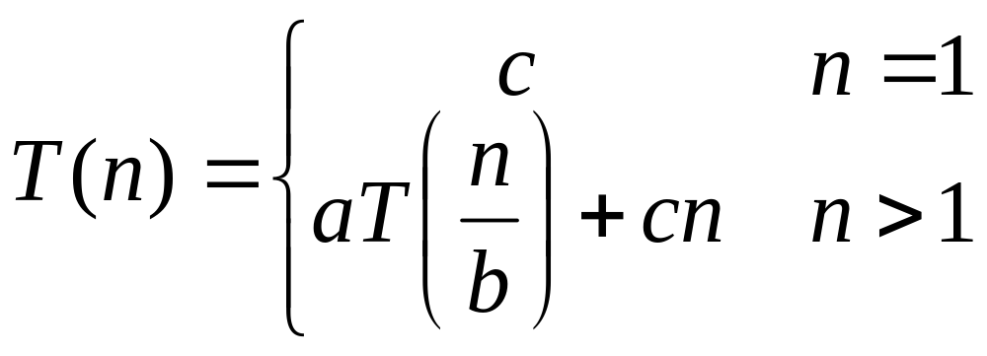
Review: Solving Recurrences
The “iteration method”
  Expand the recurrence
  Work some algebra to express as a summation
  Evaluate the summation
We showed several examples, were in the middle of:
David Luebke <number> 11/08/26

Slide 10
T(n) =
aT(n/b) + cn
a(aT(n/b/b) + cn/b) + cn
a²T(n/b²) + cna/b + cn
a²T(n/b²) + cn(a/b + 1)
a²(aT(n/b²/b) + cn/b²) + cn(a/b + 1)
a³T(n/b³) + cn(a²/b²) + cn(a/b + 1)
a³T(n/b³) + cn(a²/b² + a/b + 1)
…
a^{k}T(n/b^{k}) + cn(a^{k-1}/b^{k-1} + a^{k-2}/b^{k-2} + … + a²/b² + a/b + 1)
David Luebke <number> 11/08/26

Slide 11
So we have
  T(n) = a^{k}T(n/b^{k}) + cn(a^{k-1}/b^{k-1} + ... + a²/b² + a/b + 1)
For k = log_{b} n
  n = b^{k}
  T(n) = a^{k}T(1) + cn(a^{k-1}/b^{k-1} + ... + a²/b² + a/b + 1)
  = a^{k}c + cn(a^{k-1}/b^{k-1} + ... + a²/b² + a/b + 1)
  = ca^{k} + cn(a^{k-1}/b^{k-1} + ... + a²/b² + a/b + 1)
  = cna^{k} /b^{k} + cn(a^{k-1}/b^{k-1} + ... + a²/b² + a/b + 1)
  = cn(a^{k}/b^{k} + ... + a²/b² + a/b + 1)
David Luebke <number> 11/08/26

Slide 12
So with k = log_{b} n
  T(n) = cn(a^{k}/b^{k} + ... + a²/b² + a/b + 1)
What if a = b?
  T(n) = cn(k + 1)
  = cn(log_{b} n + 1)
  = Θ(n log n)
David Luebke <number> 11/08/26

Slide 13
So with k = log_{b} n
  T(n) = cn(a^{k}/b^{k} + ... + a²/b² + a/b + 1)
What if a < b?
David Luebke <number> 11/08/26

Slide 14
So with k = log_{b} n
  T(n) = cn(a^{k}/b^{k} + ... + a²/b² + a/b + 1)
What if a < b?
  Recall that Σ(x^{k} + x^{k-1} + … + x + 1) = (x^{k+1} -1)/(x-1)
David Luebke <number> 11/08/26

Slide 15
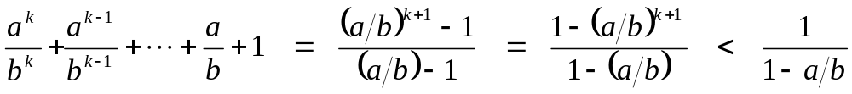
So with k = log_{b} n
  T(n) = cn(a^{k}/b^{k} + ... + a²/b² + a/b + 1)
What if a < b?
  Recall that (x^{k} + x^{k-1} + … + x + 1) = (x^{k+1} -1)/(x-1)
  So:
David Luebke <number> 11/08/26

Slide 16
So with k = log_{b} n
  T(n) = cn(a^{k}/b^{k} + ... + a²/b² + a/b + 1)
What if a < b?
  Recall that Σ(x^{k} + x^{k-1} + … + x + 1) = (x^{k+1} -1)/(x-1)
  So:
  T(n) = cn ·Θ(1) = Θ(n)
David Luebke <number> 11/08/26

Slide 17
So with k = log_{b} n
  T(n) = cn(a^{k}/b^{k} + ... + a²/b² + a/b + 1)
What if a > b?
David Luebke <number> 11/08/26

Slide 18
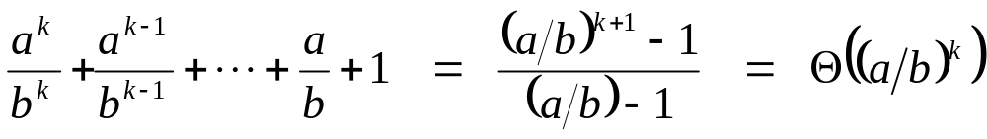
So with k = log_{b} n
  T(n) = cn(a^{k}/b^{k} + ... + a²/b² + a/b + 1)
What if a > b?
David Luebke <number> 11/08/26

Slide 19
So with k = log_{b} n
  T(n) = cn(a^{k}/b^{k} + ... + a²/b² + a/b + 1)
What if a > b?
  T(n) = cn · Θ(a^{k} / b^{k})
David Luebke <number> 11/08/26

Slide 20
So with k = log_{b} n
  T(n) = cn(a^{k}/b^{k} + ... + a²/b² + a/b + 1)
What if a > b?
  T(n) = cn · Θ(a^{k} / b^{k})
  = cn · Θ(a^{log n} / b^{log n}) = cn · Θ(a^{log n} / n)
David Luebke <number> 11/08/26

Slide 21
So with k = log_{b} n
  T(n) = cn(a^{k}/b^{k} + ... + a²/b² + a/b + 1)
What if a > b?
  T(n) = cn · Θ(a^{k} / b^{k})
  = cn · Θ(a^{log n} / b^{log n}) = cn · Θ(a^{log n} / n)
  recall logarithm fact: a^{log n} = n^{log a}
David Luebke <number> 11/08/26

Slide 22
So with k = log_{b} n
  T(n) = cn(a^{k}/b^{k} + ... + a²/b² + a/b + 1)
What if a > b?
  T(n) = cn · Θ(a^{k} / b^{k})
  = cn · Θ(a^{log n} / b^{log n}) = cn · Θ(a^{log n} / n)
  recall logarithm fact: a^{log n} = n^{log a}
  = cn · Θ(n^{log a} / n) = Θ(cn · n^{log a} / n)
David Luebke <number> 11/08/26

Slide 23
So with k = log_{b} n
  T(n) = cn(a^{k}/b^{k} + ... + a²/b² + a/b + 1)
What if a > b?
  T(n) = cn · Θ(a^{k} / b^{k})
  = cn · Θ(a^{log n} / b^{log n}) = cn · Θ(a^{log n} / n)
  recall logarithm fact: a^{log n} = n^{log a}
  = cn · Θ(n^{log a} / n) = Θ(cn · n^{log a} / n)
  = Θ(n^{log a} )
David Luebke <number> 11/08/26

Slide 24
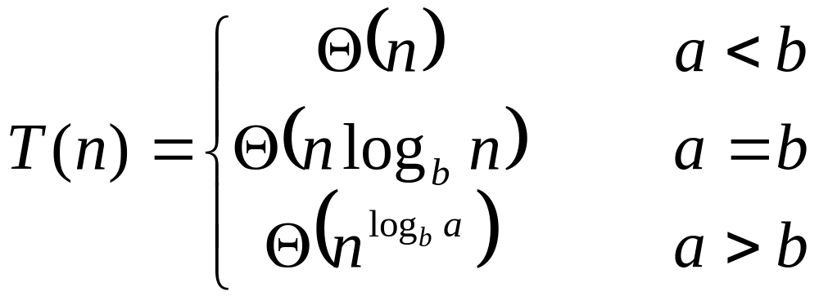
So…
David Luebke <number> 11/08/26

Slide 25
The Master Theorem
Given: a divide and conquer algorithm
  An algorithm that divides the problem of size n into a subproblems, each of size n/b
  Let the cost of each stage (i.e., the work to divide the problem + combine solved subproblems) be described by the function f(n)
Then, the Master Theorem gives us a cookbook for the algorithm’s running time:
David Luebke <number> 11/08/26

Slide 26
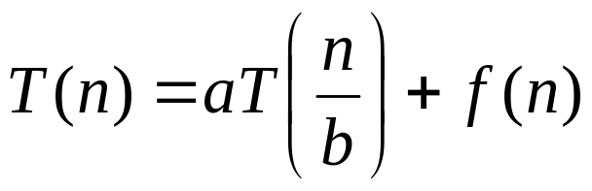
Master’s method
“Cookbook” for solving recurrences of the form:
where, a ≥ 1, b > 1, and f(n) > 0
Case 1: if f(n) = O(n^{log}_{b}^{a -ε}) for some ε > 0, then: T(n) = Θ(n^{log}_{b}ª)
Case 2: if f(n) = Θ(n^{log}_{b}ª), then: T(n) = Θ(n^{log}_{b}ª lgn)
Case 3: if f(n) = Ω(n^{log}_{b}^{a +ε}) for some ε > 0, and if
af(n/b) ≤ cf(n) for some c < 1 and all sufficiently large n, then:
T(n) = Θ(f(n))
regularity condition

Slide 27
Using The Master Method
T(n) = 9T(n/3) + n
  a=9, b=3, f(n) = n
  n^{logb a} = n^{log3 9} = Θ(n²)
  Since f(n) = O(n^{log3 9 - ε}), where ε=1, case 1 applies:
  Thus the solution is T(n) = Θ(n²)
David Luebke <number> 11/08/26

Slide 28
Examples
T(n) = 2T(n/2) + n
a = 2, b = 2, log₂2 = 1
Compare n^{log}₂² with f(n) = n
⇒ f(n) = Θ(n) ⇒ Case 2
⇒ T(n) = Θ(nlgn)

Slide 29
Examples
T(n) = 2T(n/2) + n²
a = 2, b = 2, log₂2 = 1
Compare n with f(n) = n²
⇒ f(n) = Ω(n^{1+ε}) Case 3 ⇒ verify regularity cond.
a f(n/b) ≤ c f(n)
⇔ 2 n²/4 ≤ c n² ⇒ c = ½ is a solution (c<1)
⇒ T(n) = Θ(n²)

Slide 30

Examples (cont.)
T(n) = 2T(n/2) +
a = 2, b = 2, log₂2 = 1
Compare n with f(n) = n^{1/2}
⇒ f(n) = O(n^{1-ε}) Case 1
⇒ T(n) = Θ(n)

Slide 31
Recursion-tree method
A recursion tree models the costs (time) of a recursive execution of an algorithm.

Slide 32
Example of recursion tree
Solve T(n) = T(n/4) + T(n/2) + n²:

Slide 33
Example of recursion tree
Solve T(n) = T(n/4) + T(n/2) + n²:
T(n)

Slide 34
Example of recursion tree
Solve T(n) = T(n/4) + T(n/2) + n²:
n²
T(n/4)
T(n/2)

Slide 35
Example of recursion tree
Solve T(n) = T(n/4) + T(n/2) + n²:
n²
(n/4)²
(n/2)²
T(n/16)
T(n/8)
T(n/8)
T(n/4)

Slide 36
Example of recursion tree
Solve T(n) = T(n/4) + T(n/2) + n²:
n²
(n/4)²
(n/2)²
(n/16)²
(n/8)²
(n/8)²
(n/4)²
…
Θ(1)

Slide 37

Example of recursion tree
Solve T(n) = T(n/4) + T(n/2) + n²:
n²
(n/4)²
(n/2)²
(n/16)²
(n/8)²
(n/8)²
(n/4)²
…
Θ(1)

Slide 38
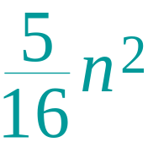
Example of recursion tree
Solve T(n) = T(n/4) + T(n/2) + n²:
n²
(n/4)²
(n/2)²
(n/16)²
(n/8)²
(n/8)²
(n/4)²
…
Θ(1)

Slide 39
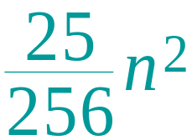
Example of recursion tree
Solve T(n) = T(n/4) + T(n/2) + n²:
n²
(n/4)²
(n/2)²
(n/16)²
(n/8)²
(n/8)²
(n/4)²
…
…
Θ(1)

Slide 40
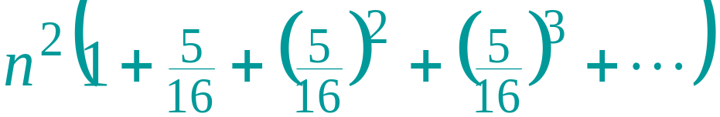
Example of recursion tree
Solve T(n) = T(n/4) + T(n/2) + n²:
n²
(n/4)²
(n/2)²
(n/16)²
(n/8)²
(n/8)²
(n/4)²
…
…
Θ(1)
Total =
= Θ(n²)
geometric series

Slide 41
Examples
Ex. T(n) = 4T(n/2) + n
a = 4, b = 2 ⇒ n^{logba} = n²; f (n) = n.
f (n) = O(n^{2 – ε}) for ε = 1 => Case 1
∴ T(n) = Θ(n²).
Ex. T(n) = 4T(n/2) + n²
a = 4, b = 2 ⇒ n^{logba} = n²; f (n) = n².
f (n) = Θ(n²) => Case 2
∴ T(n) = Θ(n²lg n).

Slide 42
Examples
Ex. T(n) = 4T(n/2) + n³
a = 4, b = 2 ⇒ n^{logba} = n²; f (n) = n³.
f (n) = Ω(n^{2 + ε}) for ε = 1 => Case 3
and 4(cn/2)³ ≤ cn³ (reg. cond.) for c = 1/2.
∴ T(n) = Θ(n³).

